Slide 1
NewLaw Solicitors
Lasting Power of Attorney

Slide 2

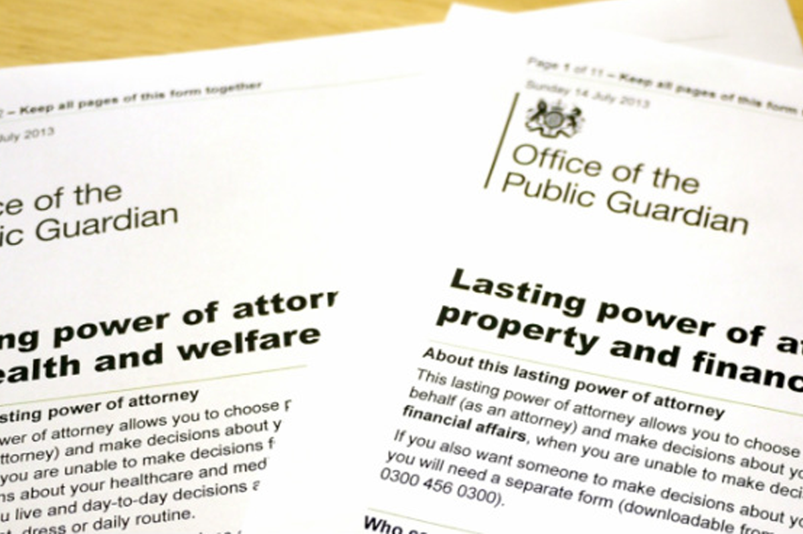


Why Make a Lasting Power of Attorney (LPA)
Making an LPA is as important as making a Will
  Making an LPA is the only way you
  can be sure someone you trust
  is able to manage your affairs
  should you be unable to due to
  physical or mental incapacity
  caused by Illness or injury
new-law.co.uk

Slide 3
Why make an LPA
Why make an LPA?
Infirmity
Dementia
Benefits of an LPA
Plan in advance
Consider what decisions can be made on your behalf
Learning disabilities
Mental health problems
Stroke or head injuries
Choose who can make those decisions and how they should make them
Illness
If you do not have an LPA and lose capacity your loved ones would have to apply for a Deputyship Order which can be costly and takes around 6 months

Slide 4

Lasting Powers of Attorney
  An LPA must be made whilst someone has capacity
There are two types of LPA
  Property and financial affairs – allowing an attorney to make decisions about paying bills, dealing with the bank, collecting benefits, selling your house etc
  Health and Welfare – allowing an attorney to make decisions on your treatment, care, medication, where you live etc

Slide 5
Things to consider before making your LPA
Control how money should be spent
Manage Finances
Refusing or consenting medical procedures or treatment
Day to day care or wellbeing including deciding where you live
Identify which LPA you want to make, Property & Financial Affairs, Health and Welfare or both??
Control what happens to your home

Slide 6
Choose your Attorneys
Attorneys
Must be over 18
Not bankrupt
You must trust them implicitly
They should be willing to take on the role
You can have one or more and you can add substitutes

Slide 7
Things to consider before making an LPA
If appointing more than one Attorney consider how they should act…..
Jointly & Severally
Jointly
Jointly for some decisions and jointly and severally for others
Decisions are made on their own or with others – most flexible option
Decisions have to be made by both Attorneys (you must appoint a substitute Attorney in case something happens to one of them)
Big decisions like selling a home or stopping life sustaining treatment can be made by both jointly, but everything else jointly and severally giving flexibility to act in an emergency

Slide 8
Things to consider before making your LPA
As soon as my is registered LPA (and also when I don’t have mental capacity)
Or
Property &Financial Affairs LPA - When do you want your Attorneys to be able to make decisions?
Only when I do not have metal capacity
Whilst you have capacity your Attorneys can only make decisions if you allow them to or can act with your consent, useful if you have a physical but not a mental impairment
Your Attorney may have to prove you do not have capacity each time they use the LPA
Notes:
This can make your LPA less useful as your Attorney may have to prove you do not have capacity each time they use the LPA
Whilst you have capacity your Attorneys can only make decisions if you allow them to or can act with your consent, useful if you have a physical but not a mental impairment

Slide 9
Property & Financial Affairs LPA – Preference
& instruction examples
You can add
Preferences and/or instructions
A doctor must confirm in writing I no longer have capacity
A financial Advisor must be consulted before making investments >£10K
My Attorneys must not sell my home unless in my Doctors opinion I cannot live independently
Charity payments already set up must continue
I would like my Attorneys to consult with a doctor if they do not think I have capacity to make decisions about my house
I would like my investments to be made in ethical funds
I would like my current account to maintain a balance of £2K
Or you can leave it blank and talk to your Attorneys instead

Slide 10
Things to consider before making an LPA
Health and Welfare LPA
Option 1
I give my attorneys the authority to consent or refuse life sustaining treatment
Health and Welfare LPA
Option 2
I do not give my Attorneys the authority to consent or refuse life sustaining treatment

Slide 11

LPA Registration
Once drafted, signed and witnessed correctly the LPA’s need to be registered with the Office of the Public Guardian before they can be used.
They charge a fee of £92 per LPA
The process takes around 8 – 10 weeks (when the going is good)

Slide 12
What NewLaw do…
We will take your instructions
Give advice where necessary.
Draft LPA’s in accordance with your instructions
Send your final LPA’s for signing and send you signing instructions
We offer a free safe storage facility for your LPA

Slide 13
Typical NewLaw fees
Single Wills from £150 plus VAT
Joint Mirror Wills from £200 plus VAT
LPAs from £200 plus VAT
Trusts from £500 plus VAT
Probate – Bespoke based on value and complexity

Slide 14
Referrals
Referrals and enquiries can be sent to the following email addresses:
- daniel.price@new-law.co.uk
- privateclient@new-law.co.uk
We also have a contact us section on our website
www.new-law.co.uk

