Slide 1

Online Safety
Simple steps to stay safe online
British Polio Fellowship
Kripen Dhrona – April 2026
Notes:
Welcome everyone. Today is about practical tips to stay safe online. This will be simple, not technical.

Slide 2
Why This Matters ⚠️
Scams are increasing
More of life is online
Criminals use new technology
Notes:
Explain that anyone can be targeted. Reassure them this is about confidence, not fear.

Slide 3
AI Risks 🤖
Fake voices
Deepfake videos
Very realistic scams
Notes:
Explain AI simply: it makes scams look and sound real, but the tactics are the same.

Slide 4

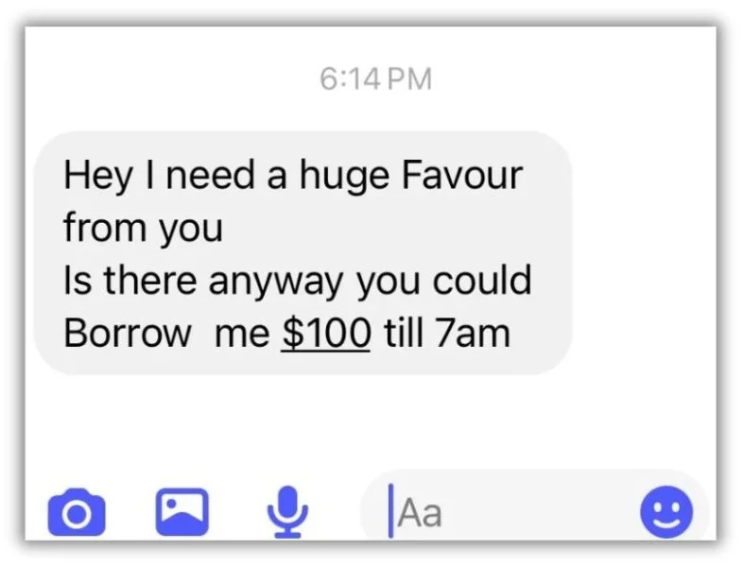
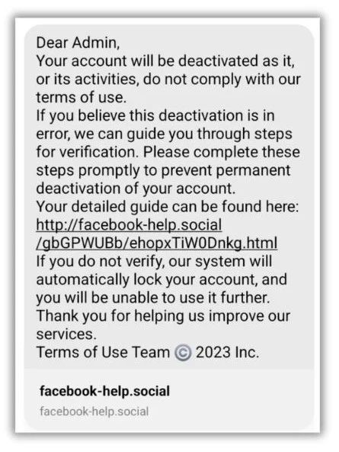
Social Media Cloning 👤
Fake profiles copy real people
Target your friends
Ask for money or help
Notes:
Explain cloning: someone copies your profile and messages your contacts.

Slide 5
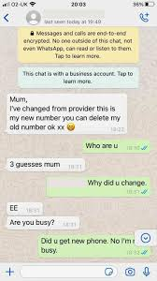
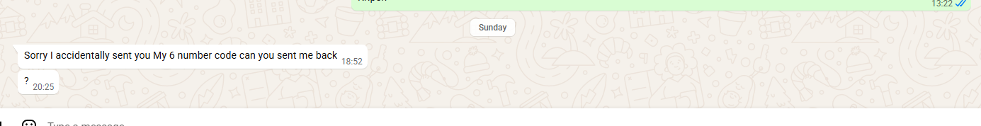
WhatsApp Scam 📱
Urgent message
Unknown number
Emotional pressure
Notes:
Ask: what looks suspicious? Then highlight urgency and unknown number.

Slide 6
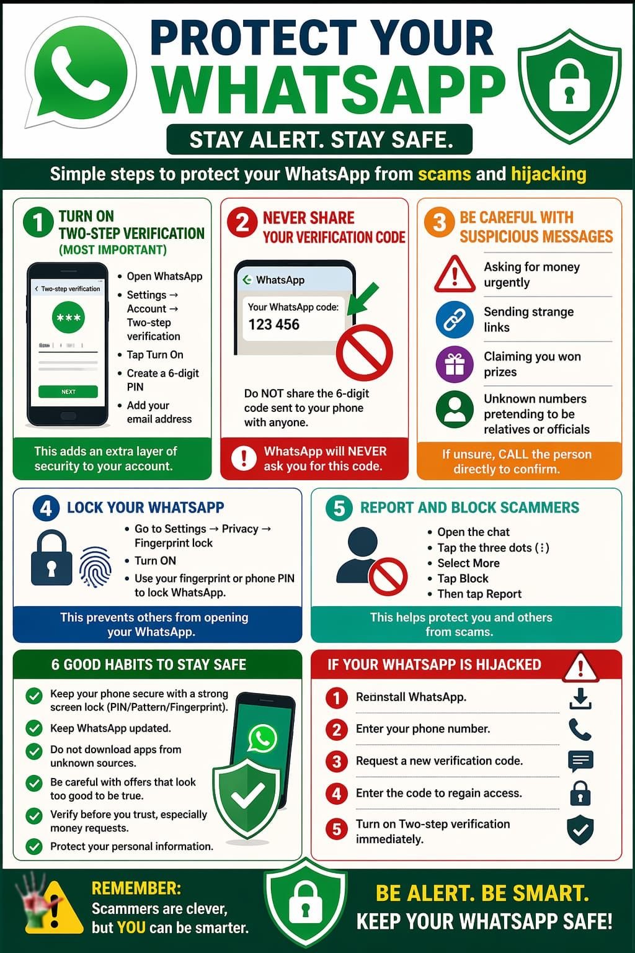

Slide 7
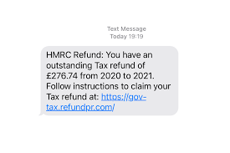
HMRC Scam ⚠️
Unexpected refund
Link to click
Too good to be true
Notes:
Explain phishing: scammers want you to click links and enter details.

Slide 8
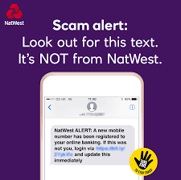
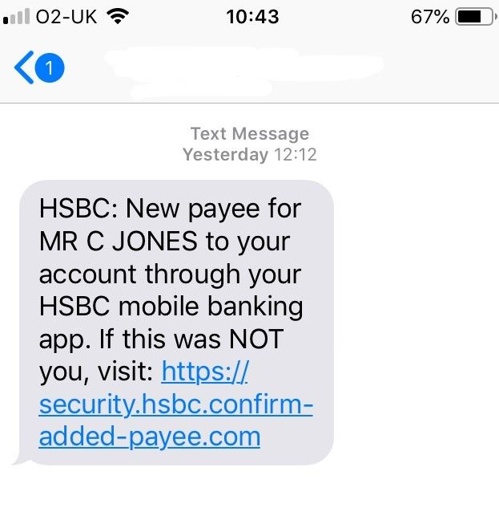
Bank Scam 🏦
Pretends to be your bank
Urgent warning
Tries to create panic
Notes:
Explain impersonation scams and never sharing details.

Slide 9

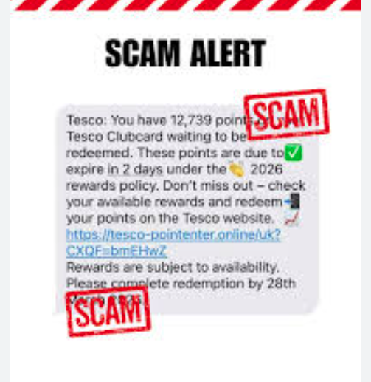
Online Shopping
Go to legitimate sites
Be careful of adds on social media
Is it to good to be true?
Be vary of how you are paying
Loyalty scheme scams
https://www.met.police.uk/advice/advice-and-information/fa/fraud/personal-fraud/online-shopping/
Fraudsters often use stock images or other people’s images, or use the same image on multiple websites/adverts. You can check if images appear elsewhere on the internet through websites like TinEye or reverse.photos.

Slide 10
How to Stay Safe 🔒
Pause before acting
Verify independently
Call back on known numbers
Don’t click unknown links
Are you being rushed???
Talk to family or friends
Use antivirus /spam software on all devices
Password protocols
Pin protocols
Two factor Authorisation
Being aware of your surroundings – both online and in person
Are you oversharing? Who are you sharing with?
Notes:
Reinforce simple actions. This is the most important slide.

Slide 11
Where to Get Help ☎️
Action Fraud-Report Fraud
https://www.reportfraud.police.uk/
https://www.reportfraud.police.uk/collection/a-z-fraud/
Your bank
Local Authority
The Police
Charities such as Age UK, Scope etc..
Not our area of expertise, but if needs be
British Polio Fellowship
Notes:
Explain Action Fraud briefly and encourage reaching out.

Slide 12
Much of modern life is online
Think how you would act in real life and the same applies online

Slide 13
Final Message
Take your time
Be skeptical
Err on the side of caution
If in doubt check
You can stay safe
Notes:
End with reassurance and confidence.

